Slide 1
Verilog Synthesis
ECE 369 University of Arizona

Slide 2
Code will not synthesize if it contains:
real data type
time data type
delays e.g. #10
force and release data types
assign and deassign of reg data types. Assignments for wires are allowed
In always or initial blocks, assign value to a wire type.
primitives with the exception of gate level primitives
http://www.asic-world.com/verilog/synthesis2.html

Slide 3
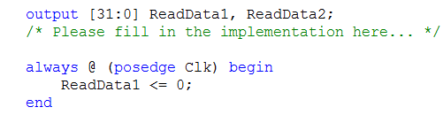


Examples (Assign value to wire)
Notice, the ReadData1 is not a reg type, by default, output is wire typed.
In always or initial blocks, assigning value to a wire is not supported for synthesis.
assign should be used if trying to assign value to a wire/output, like the following example.

Slide 4

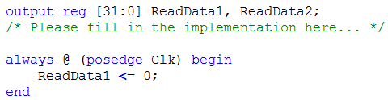
Examples (Assign value to reg)
Notice that the output ReadData1 is declared as a reg type, assign only works for
a net type (wire), assign value on a reg is not supported. Instead, use
blocking/non-blocking assignments inside always/initial blocks as shown in the
Following example.

Slide 5
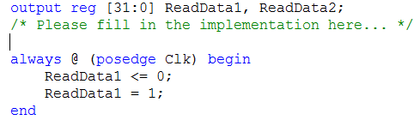
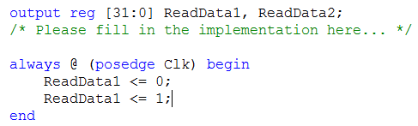
Examples (Mixing blocking and non-blocking assignments)
It is not supported by synthesis that on one signal, use both blocking and non-blocking
assignments.
Use NON-BLOCKING (<=) assignments as much as you can during the course!

Slide 6
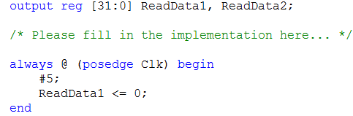
Examples (Delays)
Use delay (#5) only in your testbench for simulation.

Slide 7
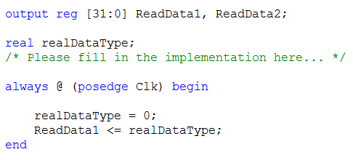
Examples (Others)

Slide 8
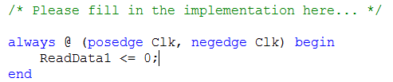
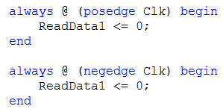
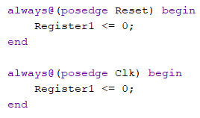
Good Practice
Don’t use posedge and negedge of the same signal in the same process.
Do not modify same register under different processes.
OR
Code above is confusing and will cause problem when synthesis.

Slide 9
Arithmetic Suggestion
When doing arithmetic with negative numbers, use the reserved keyword “signed”.
For Example:
reg signed [7:0] variable;
wire signed [7:0] variable;
input signed [7:0] variable;
function signed [7:0] variable;
Example for signed comparison:
http://www.excamera.com/sphinx/fpga-verilog-sign.html

